Slide 1

GeoCat & INSPIRE
using INSPIRE conventions to support customers in
setting up cooperative data sharing environments
Paul van Genuchten, Trang Pham @ INSPIRE Conference, Strasbourg, September 2017

Slide 2
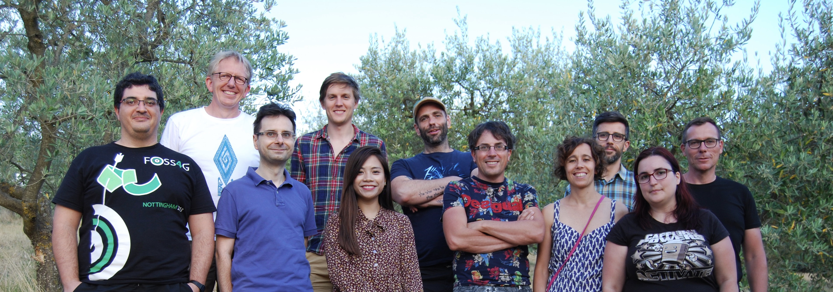

GeoCAT
Currently 11 staff, based in NL and ES
Founder of GeoNetwork
Offering services on the OSGeo Stack
GeoNetwork GeoServer PostGIS QGIS …

Slide 3

Our offerings

Slide 4

A registry for spatial assets, to facilitate discovery and accessibility
Maintenance and implementation support
Training
Development
Hosted services

Slide 5
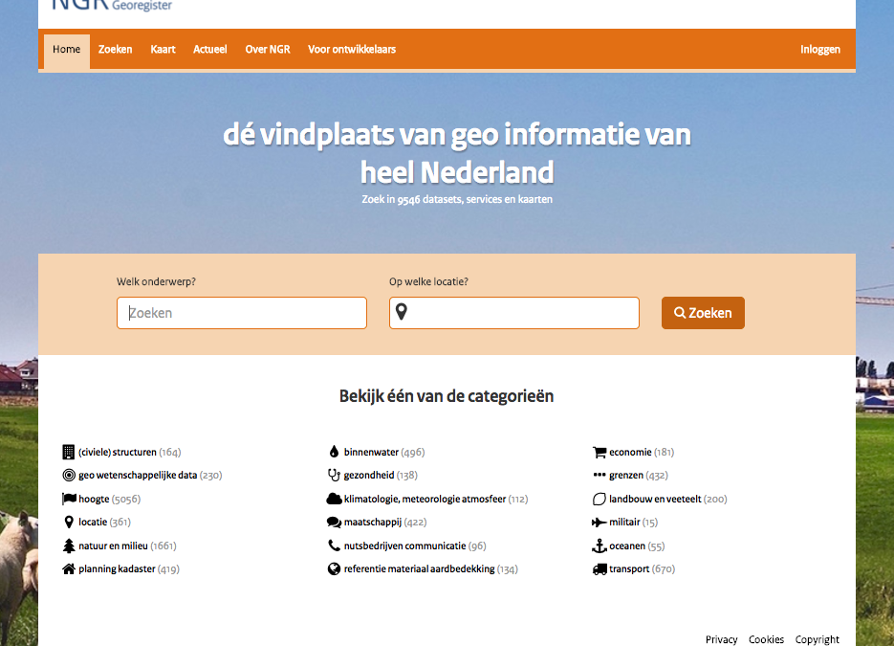

Slide 6
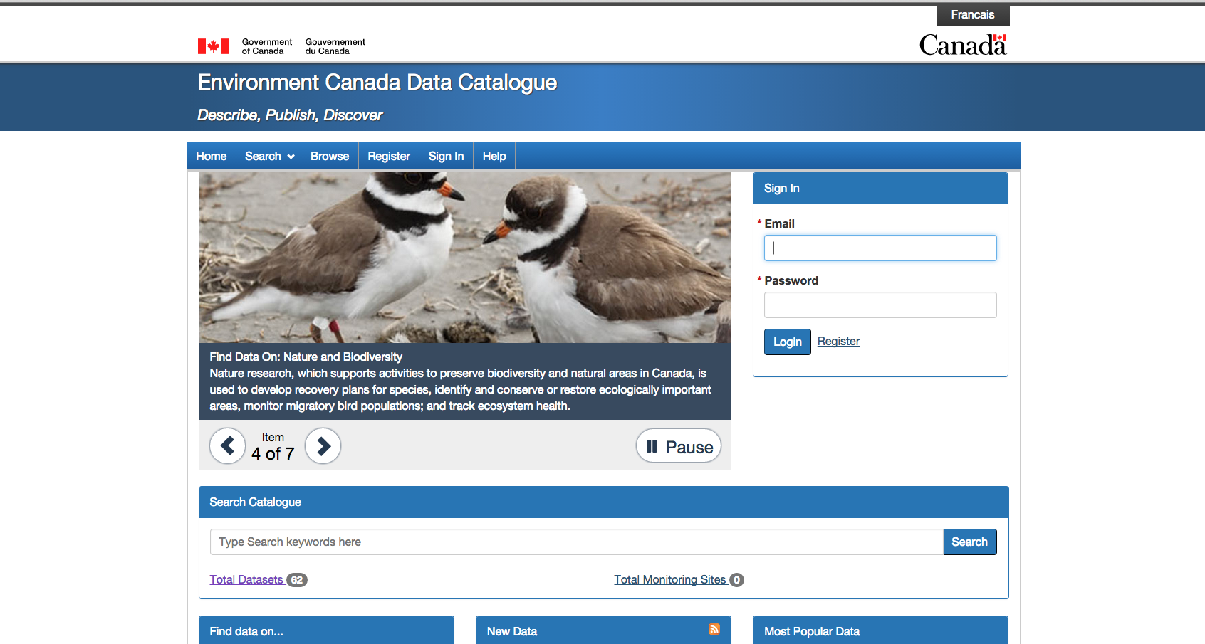

Slide 7
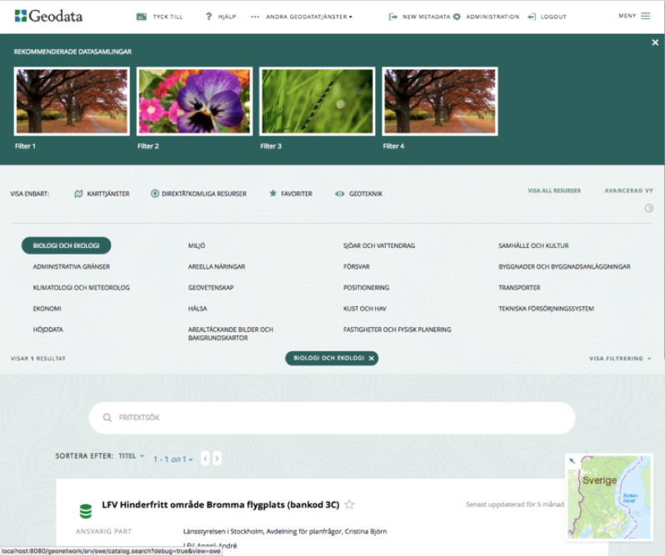

Slide 8

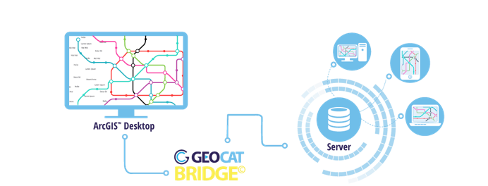
An ArcMap Extension to facilitate the migration of maps and datasets between environments

Slide 9




Slide 10
GeoCat SDI support
Support in setting up (harmonised) INSPIRE services in GeoServer/Mapserver
INSPIRE service validation, monitoring and evaluation
Training
Software development
Analyse (meta)data trends

Slide 11
GeoCat & Research/Innovation
Focussed on providing easy to use tools without detracting from underlying complexity and standards (INSPIRE harmonisation, LDProxy, INSPIRE dashboard)
Focussed on data discovery and accessibility (DCAT, search engine optimisation, schema.org)
Volunteering, Crowd sourcing, Citizen Science to improve (meta)data collection, quality and usage (Geospatial User Feedback)

Slide 12
Innovation projects
Waalweelde led by Wageningen University (2014)
COBWEB FP7 citizen science project led by Edina (2012-2016)
Open Geo Portal led by Tufts University (2013-2017)
Geo4web testbed led by GeoNovum (2016)
SDI on Docker (2016-2017)
Elise tools Geospatial User Feedback led by JRC (2017)

Slide 13
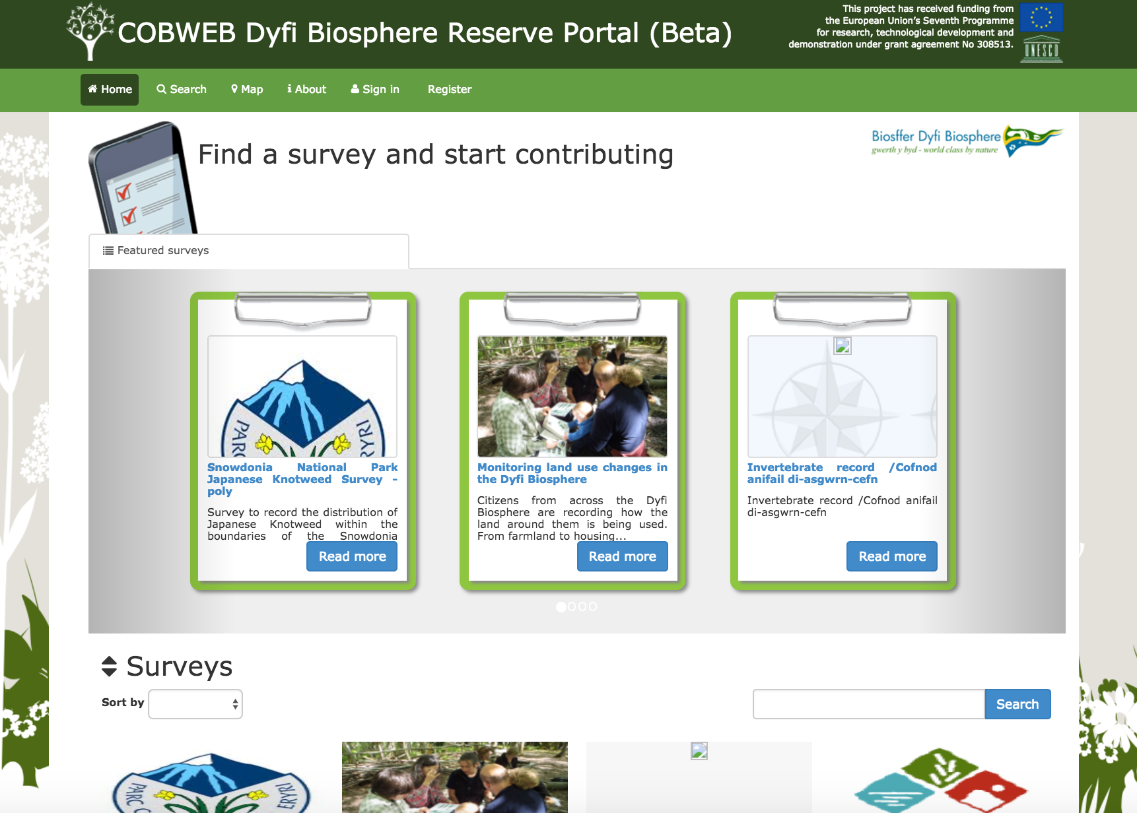

Slide 14
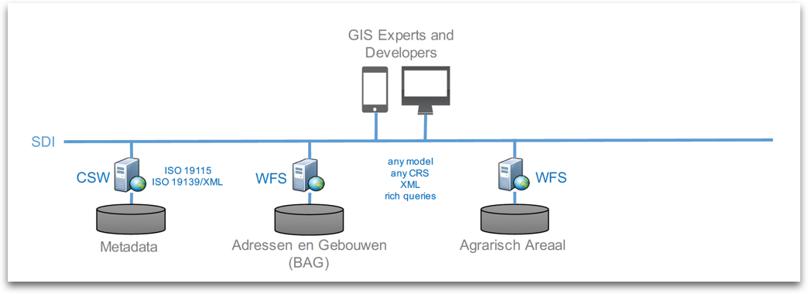
Geo4Web

Slide 15
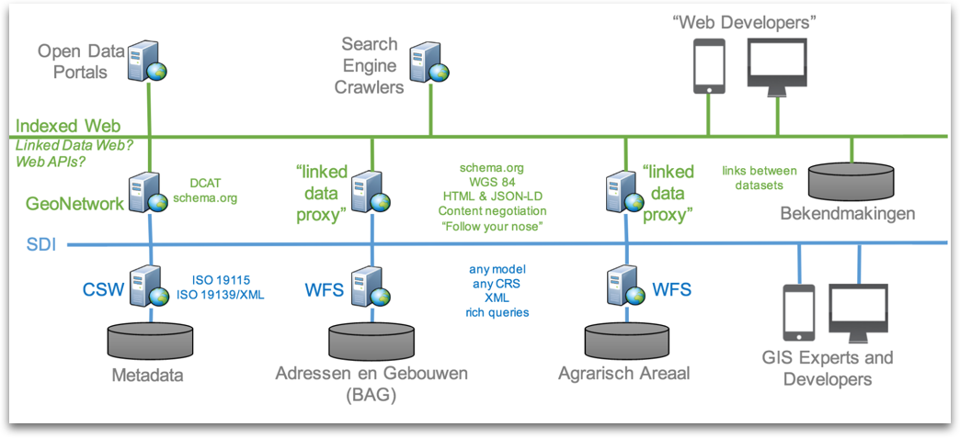

Slide 16


Projectinfo and Styling GeoPackage extension
https://github.com/pka/qgpkg/blob/master/owc_geopackage_extension.md

Slide 17
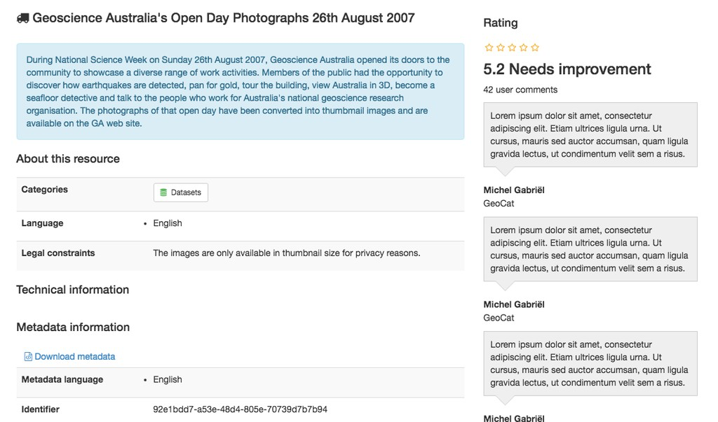
Geospatial User Feedback

Slide 18
We invite
Science groups; to design experiments related to data discovery and accessibility with us
Students; to find out about our internship and job opportunities
Specialists; to use our software and participate in its development
Organisations; to find out about our hosted services and software maintenance support options

Slide 19
We hope to hear from you at info@geocat.net

